Slide 1

CSCI 4502/5502
Data Mining - Fall 2023 - Lecture 17
Ravi Starzl, PhD

Slide 2
Midterm Review
1
Multiple Choice
2
True or False
3
Short Answers
4
Reasoning / Computing
Ravi Starzl, PhD - Data Mining Fall 2023

Slide 3
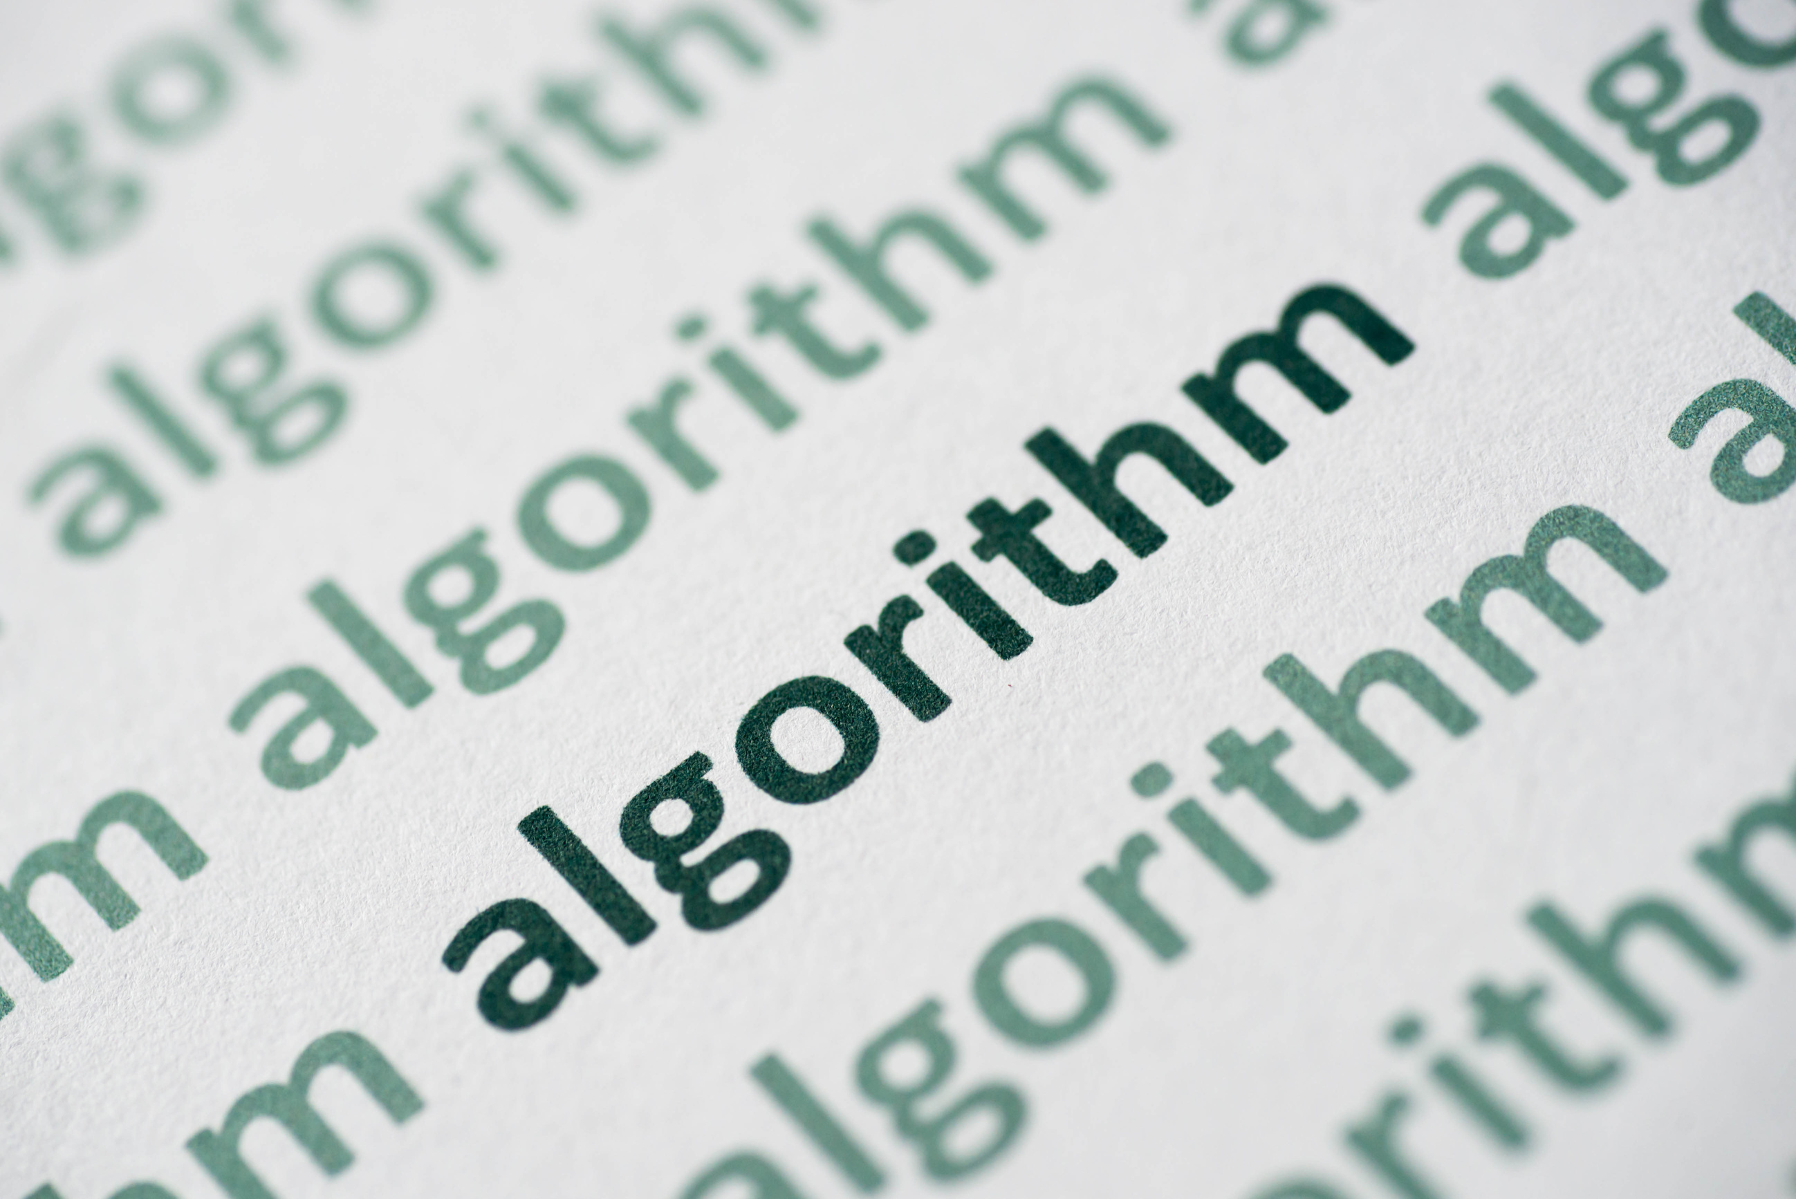
Example Q1
The Apriori algorithm, a classic algorithm used in data mining for mining frequent itemsets and relevant association rules, has certain bottlenecks. Which of the following best describes the three major bottlenecks of the Apriori algorithm?
A) Large itemset generation, computational complexity, and the need for prior knowledge.
B) Repeated database scans, large itemset generation, and computational complexity.
C) Repeated database scans, the need for prior knowledge, and memory usage.
D) Computational complexity, memory usage, and lack of scalability.
E) Lack of scalability, large itemset generation, and the need for prior knowledge.
Ravi Starzl, PhD - Data Mining Fall 2023

Slide 4
Example Q1
The Apriori algorithm, a classic algorithm used in data mining for mining frequent itemsets and relevant association rules, has certain bottlenecks. Which of the following best describes the three major bottlenecks of the Apriori algorithm?
Correct Answer: B) Repeated database scans, large itemset generation, and computational complexity.
The Apriori algorithm suffers from three key bottlenecks:
It may require multiple full scans of the database.
The generation of potentially large numbers of candidate itemsets.
The time complexity associated with counting support for candidate itemsets.
Ravi Starzl, PhD - Data Mining Fall 2023

Slide 5

Example Q2
In the context of decision tree learning algorithms, the Information Gain measure is used to decide the splitting criterion that partitions a dataset. Which of the following statements best describes Information Gain?
A) It is the measure of the increase in entropy after a dataset is split on an attribute.
B) It is the measure of the decrease in entropy after a dataset is split on an attribute.
C) It is the measure of the total entropy in a dataset without considering any attribute.
D) It is the measure of entropy within individual subsets of a dataset after it is split on an attribute.
Ravi Starzl, PhD - Data Mining Fall 2023

Slide 6
Example Q2
In the context of decision tree learning algorithms, the Information Gain measure is used to decide the splitting criterion that partitions a dataset. Which of the following statements best describes Information Gain?
Correct Answer: B) It is the measure of the decrease in entropy after a dataset is split on an attribute.
Information Gain is a statistical property that measures the expected reduction in the impurity of the target variable given additional information about it provided by the feature variables. In other words, it quantifies the "reduction in entropy" or surprise from learning the value of an attribute.
Ravi Starzl, PhD - Data Mining Fall 2023

Slide 7

Example Q3
Bayes' theorem is a fundamental concept in probabilistic data mining, particularly in the use of Naive Bayes classifiers. Which of the following correctly describes Bayes' theorem?
A) It is a theorem used to find the probability of an event given that another event has occurred.
B) It is a theorem used to determine the total probability of an event occurring.
C) It is a theorem used to calculate the joint probability of two independent events.
D) It is a theorem used to find the probability of an event not occurring.
Ravi Starzl, PhD - Data Mining Fall 2023

Slide 8
Example Q3
Bayes' theorem is a fundamental concept in probabilistic data mining, particularly in the use of Naive Bayes classifiers. Which of the following correctly describes Bayes' theorem?
Correct Answer: A) It is a theorem used to find the probability of an event given that another event has occurred.
Bayes' theorem, in probability theory and statistics, describes the probability of an event, based on prior knowledge of conditions that might be related to the event. It serves as the basis for the Bayesian framework of probabilistic modeling and inference.
Ravi Starzl, PhD - Data Mining Fall 2023

Slide 9
Midterm Review
1
Multiple Choice
2
True or False
3
Short Answers
4
Reasoning / Computing
Ravi Starzl, PhD - Data Mining Fall 2023

Slide 10

Example Q4
True or False:
If A and B are highly correlated, then either A causes B or B causes A.
Ravi Starzl, PhD - Data Mining Fall 2023

Slide 11
Example Q4
True or False:
If A and B are highly correlated, then either A causes B or B causes A.
FALSE. Correlation does NOT imply causality.
For example: more ice cream sales, more drowning instances.
Ravi Starzl, PhD - Data Mining Fall 2023

Slide 12

Example Q5
True or False:
SVM is an unsupervised learning method.
Ravi Starzl, PhD - Data Mining Fall 2023

Slide 13
Example Q5
True or False:
SVM is an unsupervised learning method.
FALSE. SVM (support vector machines) is a classification method that leverages labeled objects to identify the maximum-margin hyperplane for class separation, i.e., supervised learning method. Unsupervised learning has no pre-defined classes or labeled training data.
Ravi Starzl, PhD - Data Mining Fall 2023

Slide 14

Example Q6
True or False:
MIN(S.price) ≥ v is an anti-monotonic constraint, where MIN(S.price) is the minimum item price in itemset S
Ravi Starzl, PhD - Data Mining Fall 2023

Slide 15
Example Q6
True or False:
MIN(S.price) ≥ v is an anti-monotonic constraint, where MIN(S.price) is the minimum item price in itemset S
TRUE. Anti-monotonicity states that if S violates the constraint, then S+ must also violate the constraint. If MIN(S.price) < v, then MIN(S+.price) <= MIN(S.price) < v, since MIN() cannot increase when more items are added. As such, this constraint is anti-monotonic.
Ravi Starzl, PhD - Data Mining Fall 2023

Slide 16
Midterm Review
1
Multiple Choice
2
True or False
3
Short Answers
4
Reasoning / Computing
Ravi Starzl, PhD - Data Mining Fall 2023

Slide 17

Example Q7
Data mining aims to find interesting patterns. Identify three properties that an interesting pattern should have.
Ravi Starzl, PhD - Data Mining Fall 2023

Slide 18
Example Q7
Data mining aims to find interesting patterns. Identify three properties that an interesting pattern should have.
Valid, novel, potentially useful, ultimately understandable by human
Ravi Starzl, PhD - Data Mining Fall 2023

Slide 19
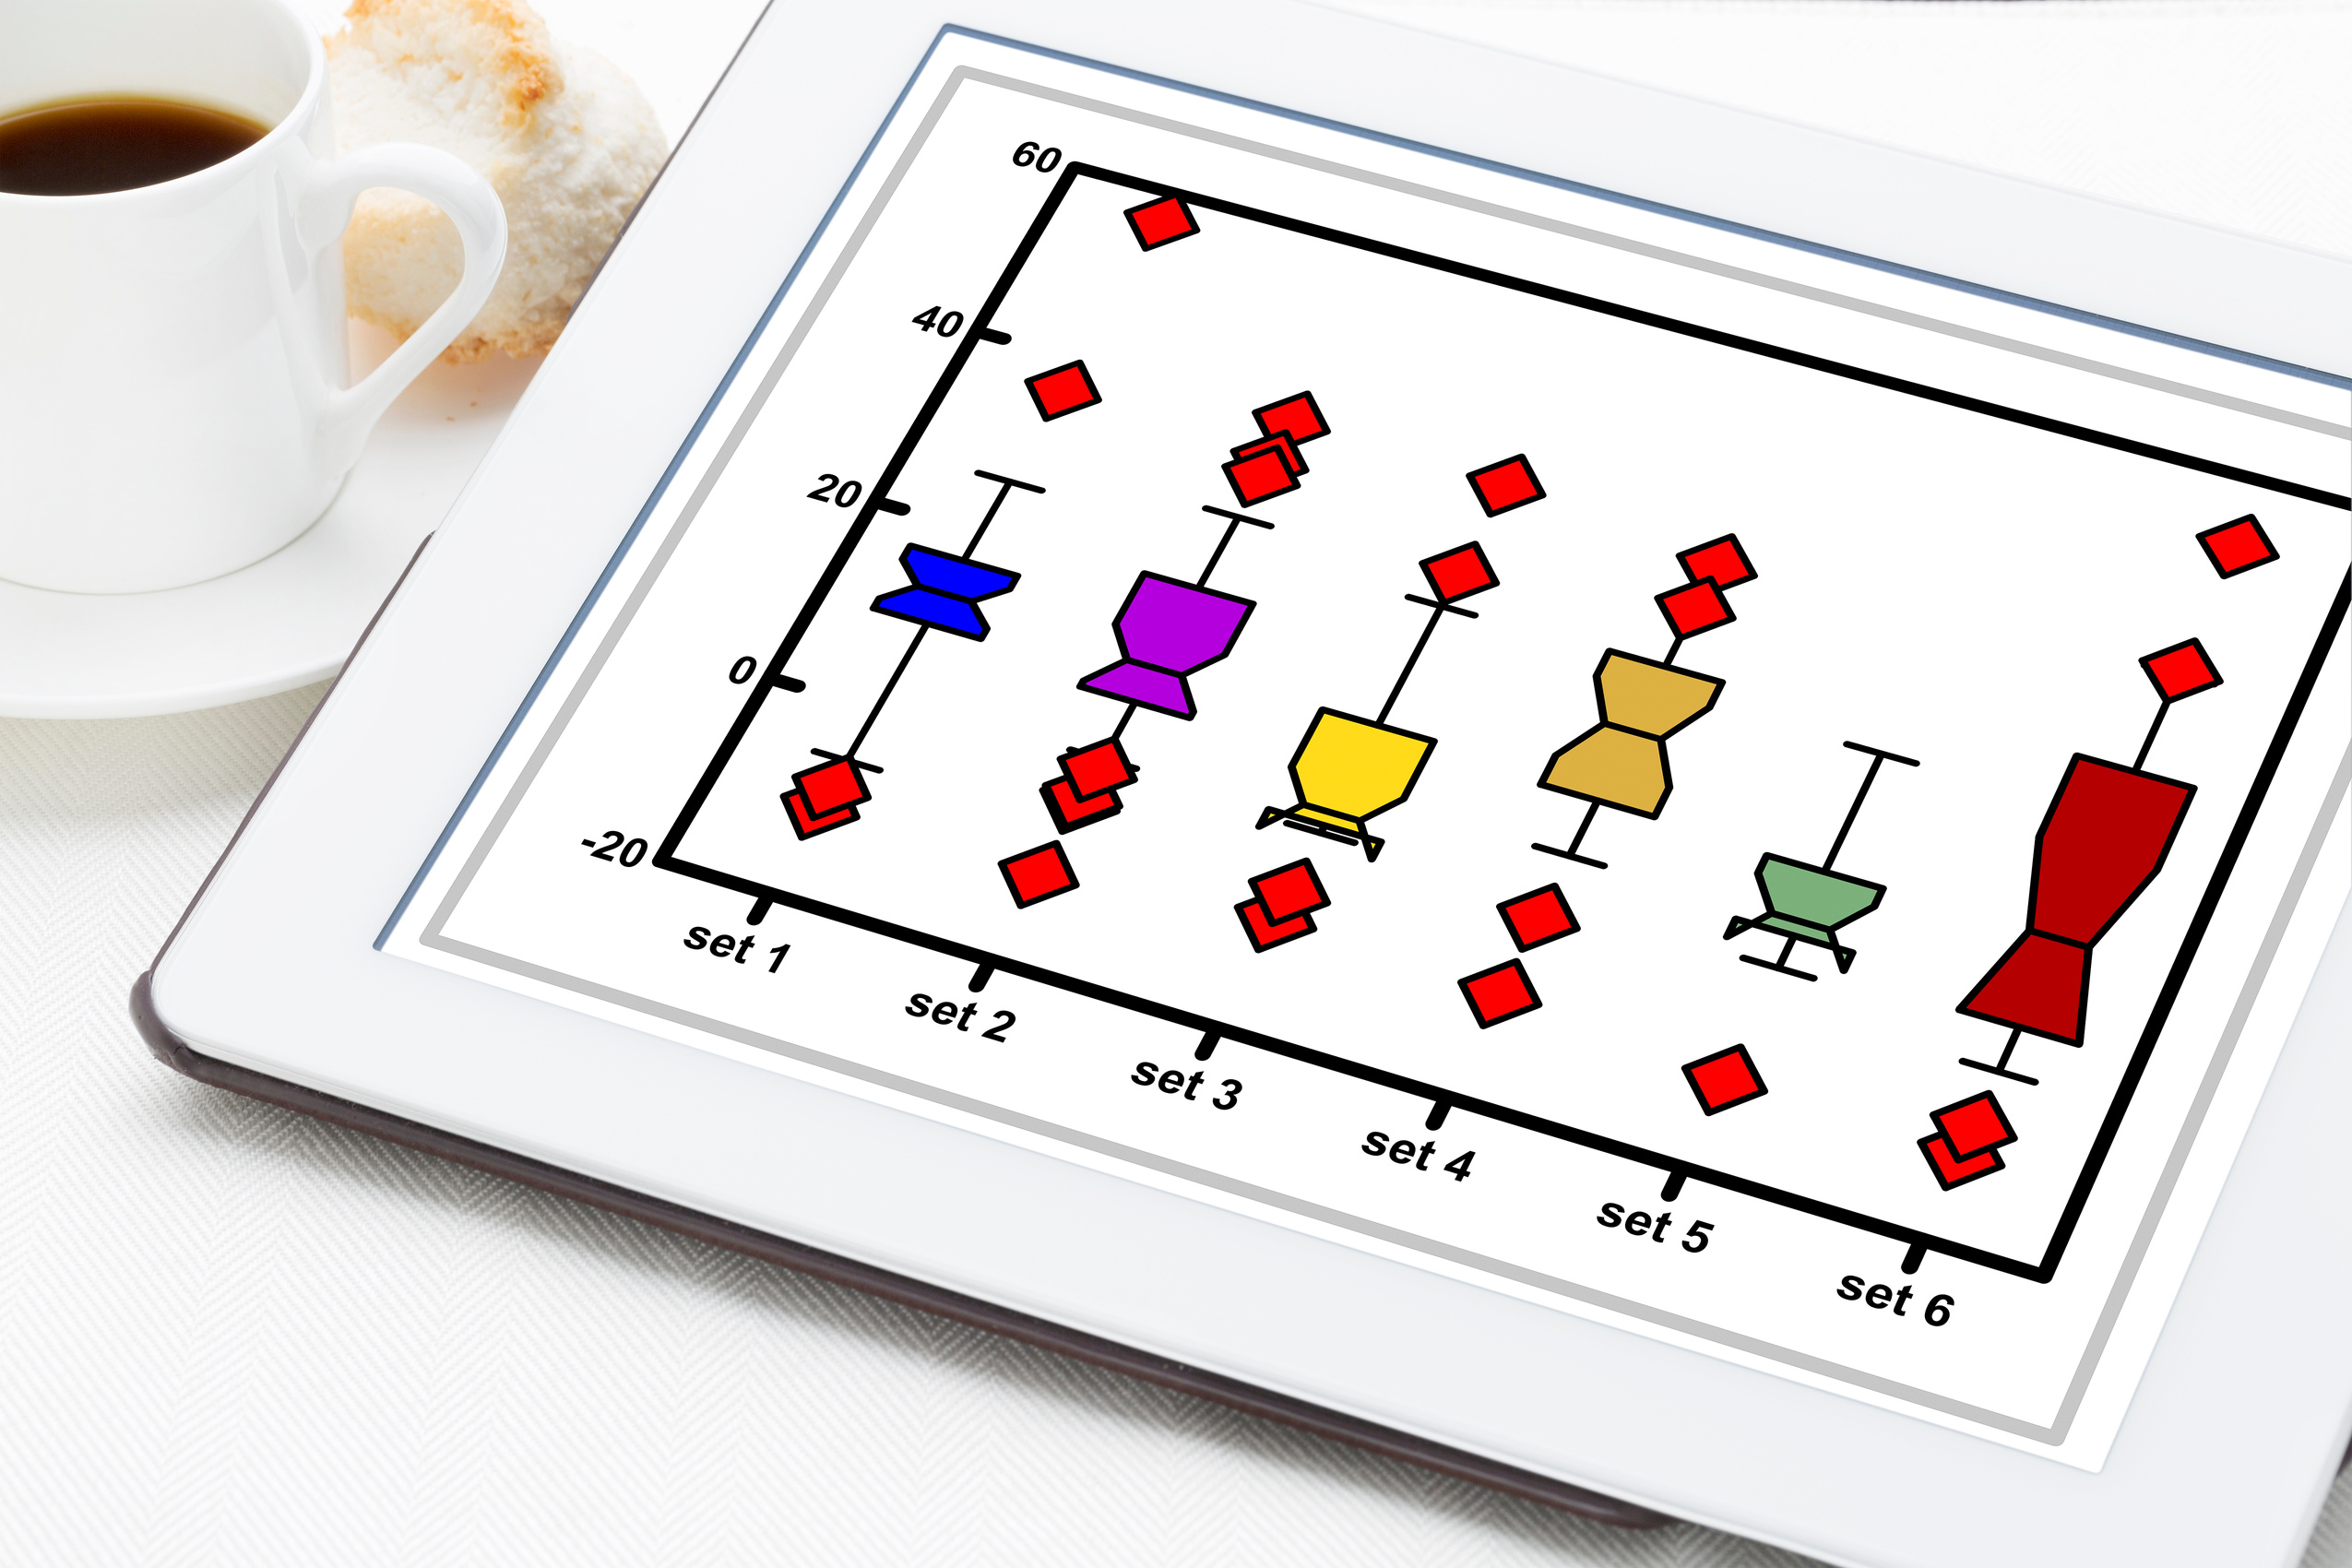
Example Q8
What information is shown in a box plot?
Ravi Starzl, PhD - Data Mining Fall 2023

Slide 20
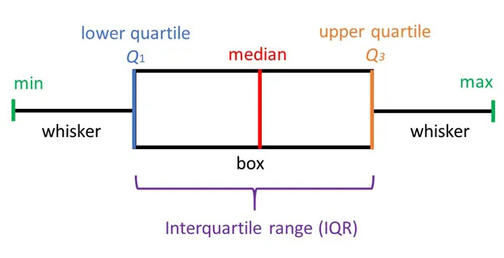
Example Q8
What information is shown in a box plot?
Q1, Q2 (median), Q3, IQR
whiskers (min, max, or 1.5xIQR and outliers)
Figure by Ravi Kiran Sirigiri
https://medium.com/@ravikiransirigiri4215/box-and-whisker-plot-box-plot-9f595839ee21
Ravi Starzl, PhD - Data Mining Fall 2023

Slide 21

Example Q9
Which classification method has better interpretability: decision tree induction or neural network? Briefly explain why.
Ravi Starzl, PhD - Data Mining Fall 2023

Slide 22
Example Q9
Which classification method has better interpretability: decision tree induction or neural network? Briefly explain why.
Decision tree induction: branching based on attributes’ values to arrive at a decision. Easy to interpret.
Neural network: hidden layers, weighted combinations, bias, activation function. Difficult to interpret.
Ravi Starzl, PhD - Data Mining Fall 2023

Slide 23
Midterm Review
1
Multiple Choice
2
True or False
3
Short Answers
4
Reasoning / Computing
Ravi Starzl, PhD - Data Mining Fall 2023

Slide 24
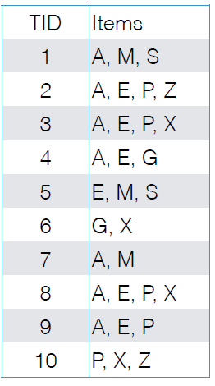
Example Q10
Consider the market basket transactions shown in the table.
Let min_support = 35%, find all frequent itemsets using the Apriori algorithm.
Ravi Starzl, PhD - Data Mining Fall 2023

Slide 25
Example Q10
Consider the market basket transactions shown in the table.
Let min_support = 35%, find all frequent itemsets using the Apriori algorithm.
10 * 35% = 3.5
frequent: at least 4 occurrences
1-itemsets
A:7, E:6, P: 5, X:4, (not G:2, M: 3, S:2, Z:2)
2-itemsets
AE:5, AP:4, EP:4, (not AX:2, EX:2, PX:3)
3-itemsets
AEP:4
Ravi Starzl, PhD - Data Mining Fall 2023

Slide 26
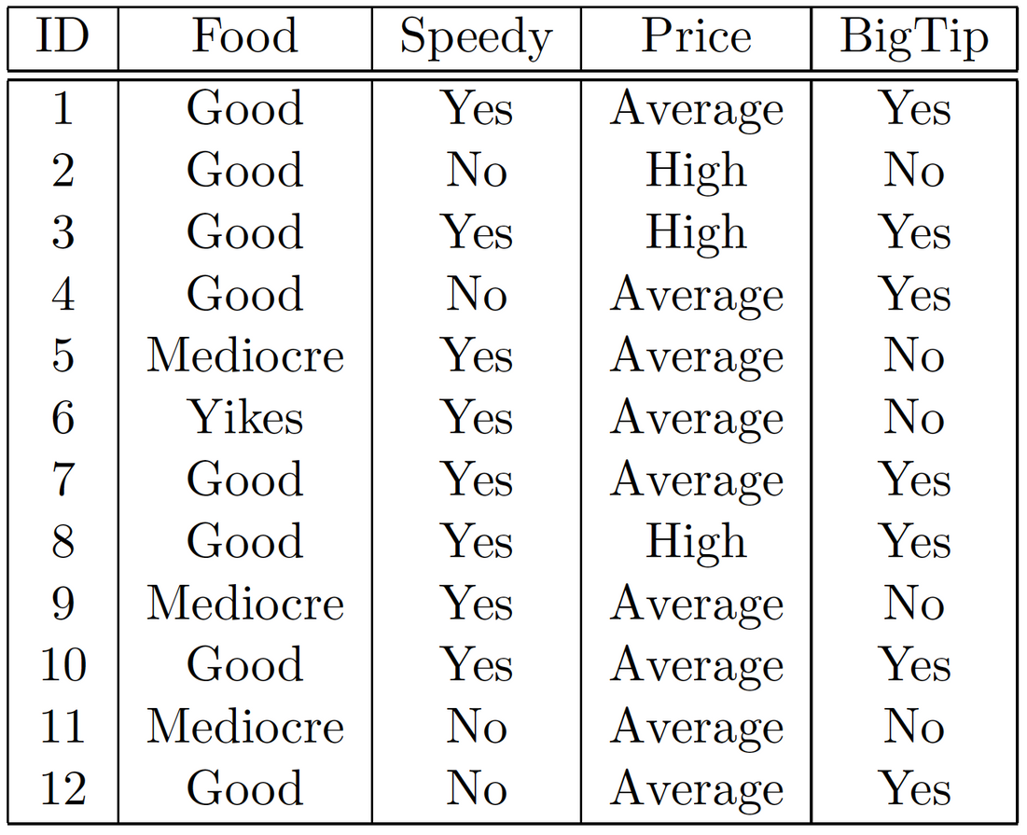
Example Q11
Consider the training examples shown in the table for a binary classification problem of the class label “Speedy”.
Using naive Bayes classifier, write out the steps for computing of the probability of “BigTip” being Yes or X = (Food=Good, Price=Average, BigTip=Yes)
Ravi Starzl, PhD - Data Mining Fall 2023

Slide 27
Example Q11
Consider the training examples shown in the table for a binary classification problem of the class label “Speedy”.
Using naive Bayes classifier, write out the steps for computing of the probability of “BigTip” being Yes or X = (Food=Good, Price=Average, BigTip=Yes)
X = (Food=Good, Price=Average, BigTip=Yes)
P(Yes) = 8/12, P(No) = 4/12
P(Yes|X) = P(X|Yes)P(Yes)/P(X)
P(Food=Good|Yes) x P(Price=Average|Yes) x P(BigTip=Yes|Yes) x P(Yes)
= 5/8 x 6/8 x 5/8 x 8/12 can ignore P(X)
Ravi Starzl, PhD - Data Mining Fall 2023

Slide 28
Thank you
A special thank you to Qin Lv for her slides, on which this lecture is based
Ravi Starzl, PhD - Data Mining Fall 2023

